Slide 1
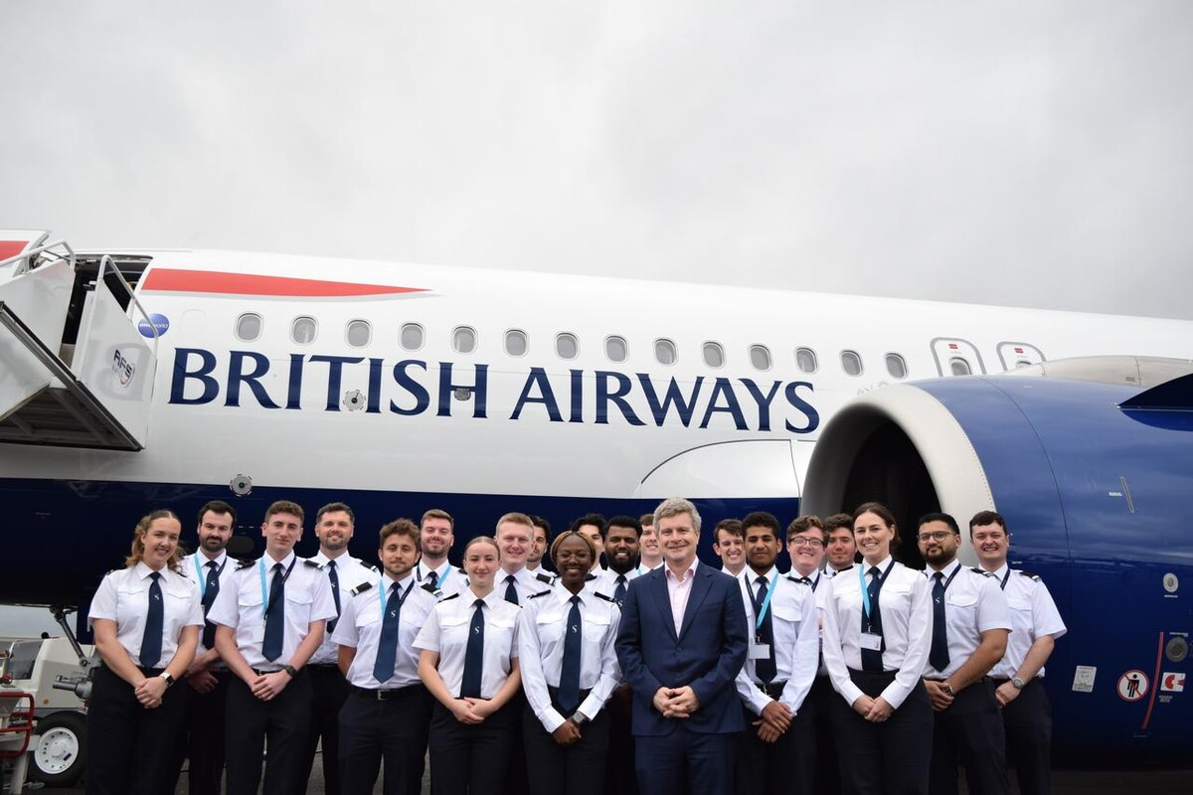

Slide 2
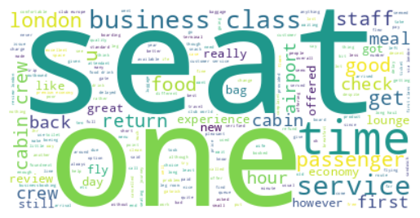
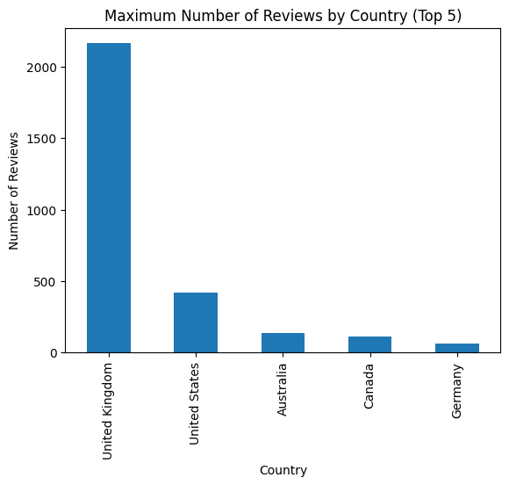
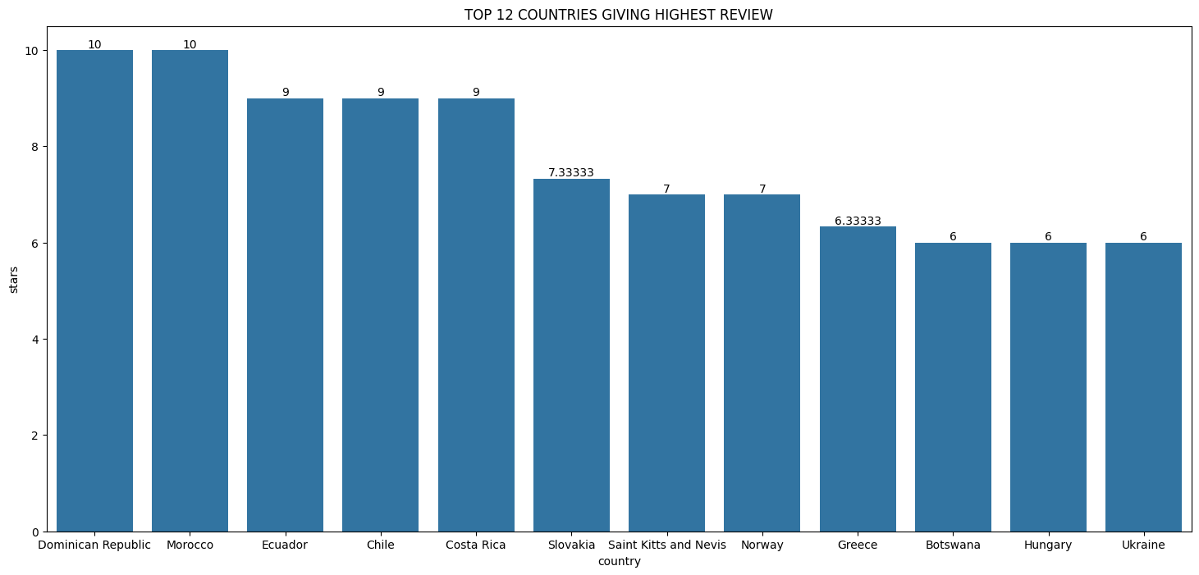
Key Metrics
Overall rating - 4.54
3411 Total reviews
collected
Reviews from 69 Countries
What customers are happy and unsatisfied about for different ratings class:
7-10 ratings wrote about comfortable seats, good inflight entertainment, descent food quality.
4-6 ratings faced problem with small entertainment screen, long passport check queue, bad business class experience.
1-3 ratings wrote dissatisfaction on congested middle seat and small screen while they liked the seats and the food.
All customers liked- abin crew friendly
attention, enhanced club europes
business class, imporvement in services,
enhanced customer care services.

